Slide 1

AME532a Group Presentation
ASW28 Model Controller Design and Simulation
Sen Yang()
Jiaoran Wang (625909903)
04/30/2020

Slide 2
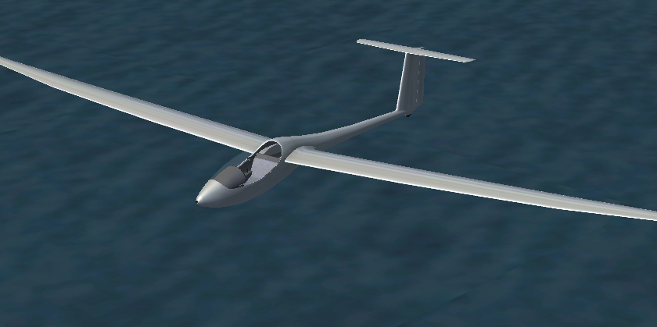
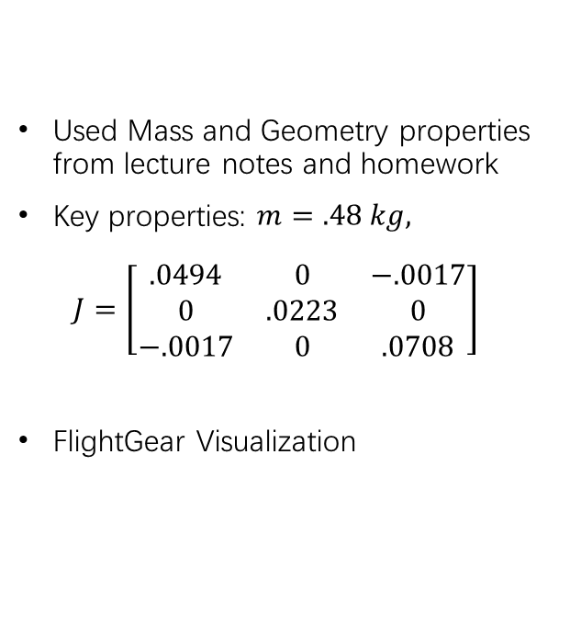
ASW-28 Aircraft
Used Mass and Geometry properties from lecture notes and homework
Key properties: $m=.48 kg,$ $J=\left[\begin{matrix}.0494 & 0 & −.0017 \\ 0 & .0223 & 0 \\ −.0017 & 0 & .0708\end{matrix}\right]$
FlightGear Visualization

Slide 3
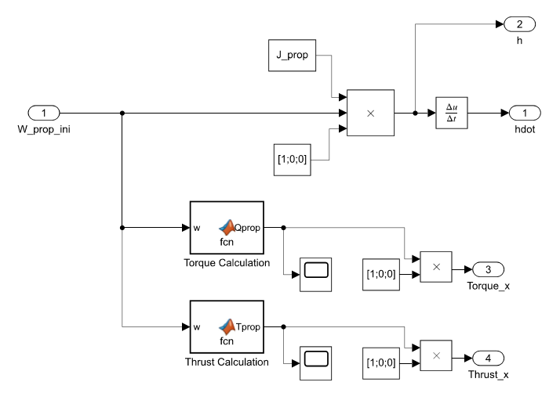
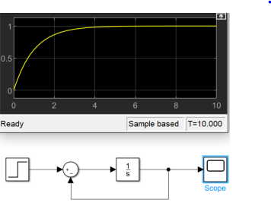
Nonlinear Dynamics Simulation
Block Diagram:
1st order actuator model
Simple Propeller Model:

Slide 4
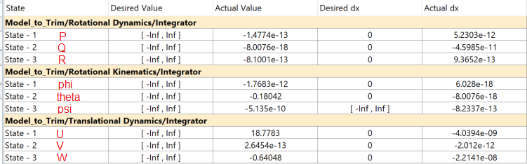
Trim & Linearization
Trim Results (Trans Kin, Propeller, 1st order actuators commented out):
Trim Condition (Glider) FlightGear Demonstration:
https://www.youtube.com/watch?v=aavscQ1y04M

Slide 5
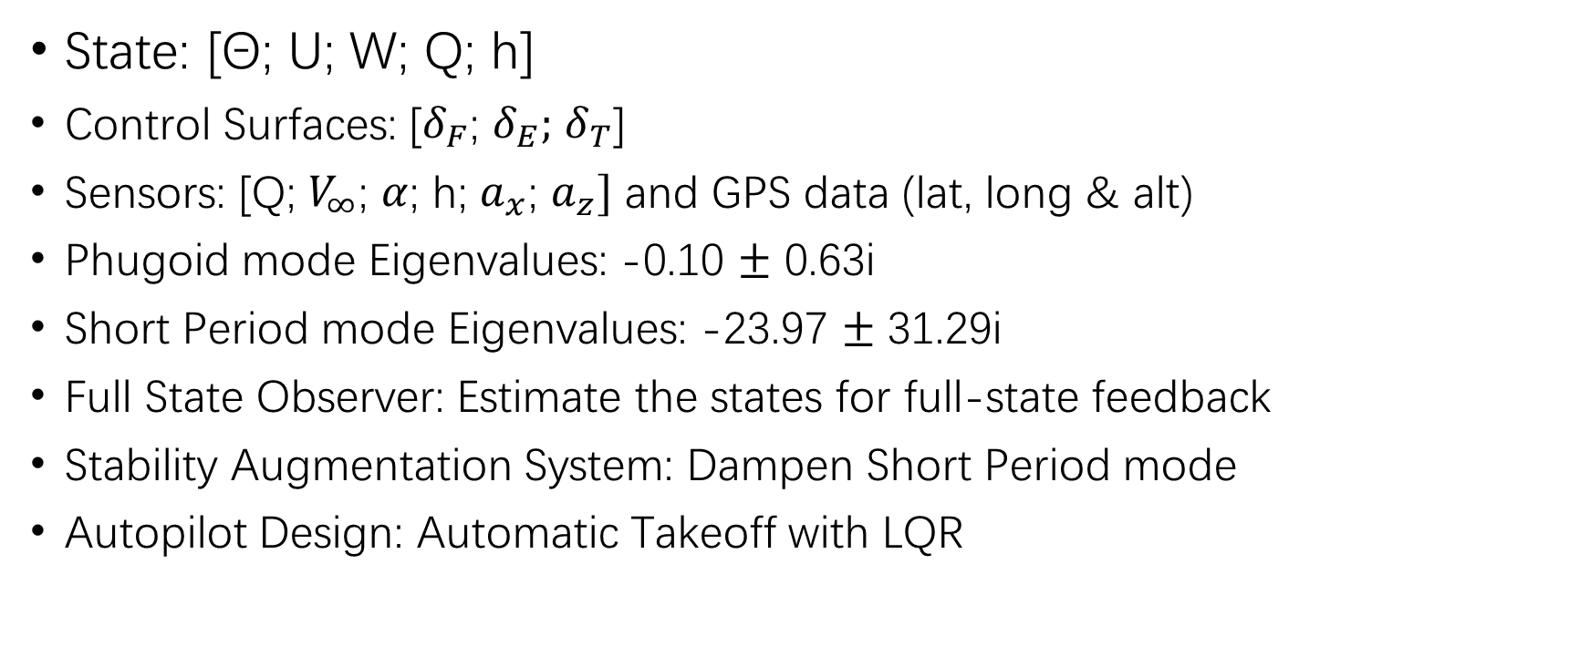
Longitudinal Mode
State: [Θ; U; W; Q; h]
Control Surfaces: [$δ_{F}$; $δ_{E};$ $δ_{T}$]
Sensors: [Q; $V_{∞}$; $α$; h; $a_{x}$; $a_{z}]$ and GPS data (lat, long & alt)
Phugoid mode Eigenvalues: -0.10 $±$ 0.63i
Short Period mode Eigenvalues: -23.97 $±$ 31.29i
Full State Observer: Estimate the states for full-state feedback
Stability Augmentation System: Dampen Short Period mode
Autopilot Design: Automatic Takeoff with LQR

Slide 6
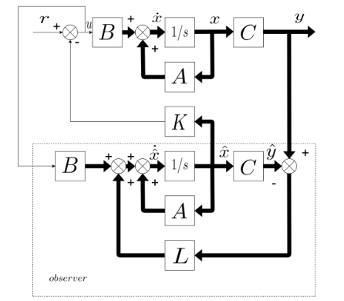
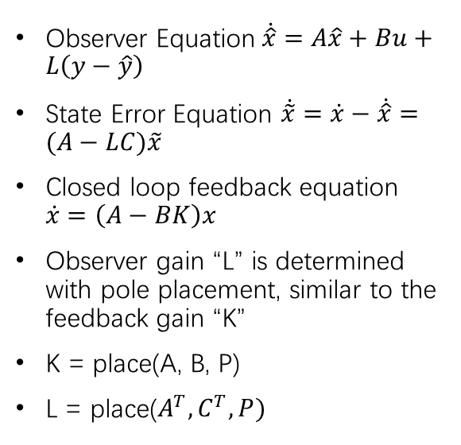
Full-State Observer
Observer Equation$\dot{\hat{x}}=A\hat{x}+Bu+L\left(y−\hat{y}\right)$
State Error Equation $\dot{\tilde{x}}=\dot{x}−\dot{\hat{x}}=(A−LC)\tilde{x}$
Closed loop feedback equation $\dot{x}=\left(A−BK\right)x$
Observer gain “L” is determined with pole placement, similar to the feedback gain “K”
K = place(A, B, P)
L = place($A^{T},C^{T},P)$

Slide 7
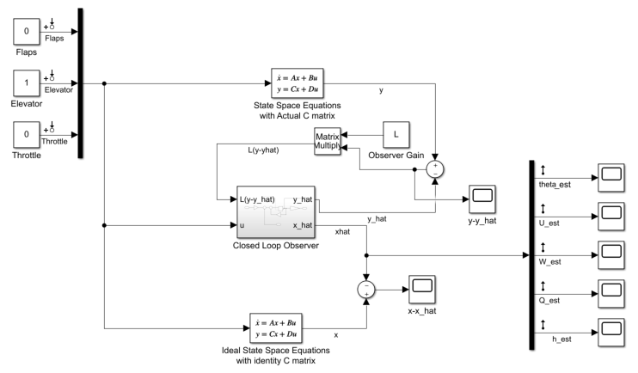
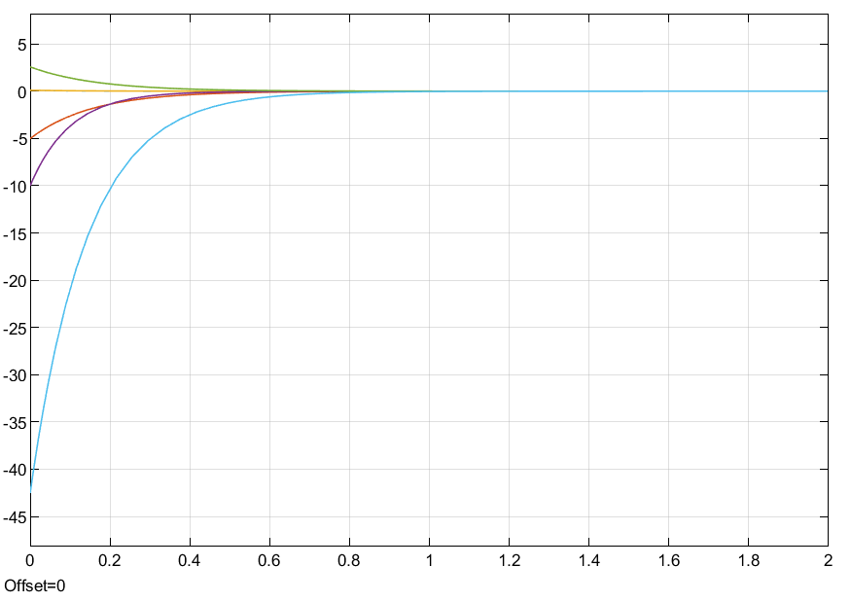
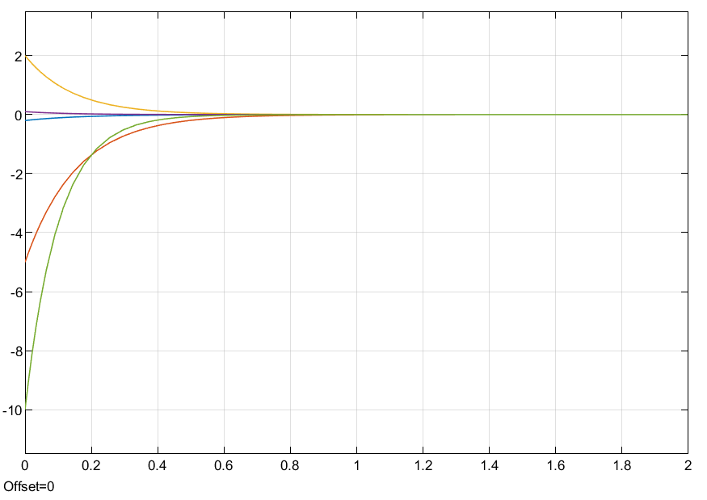


Full-State Observer
P=[-6 -6.5 -7 -7.5 -10]
“Actual” States initial conditions: [0; 0; 0; 0; 0]
“Observer” States initial conditions: [.2; 5; -2; -1; 10]
Error converges to 0 in less than 1 second
Linearized State Space System with Full-State Observer:
$$y −\dot{y}$$
$$x −\dot{x}$$

Slide 8
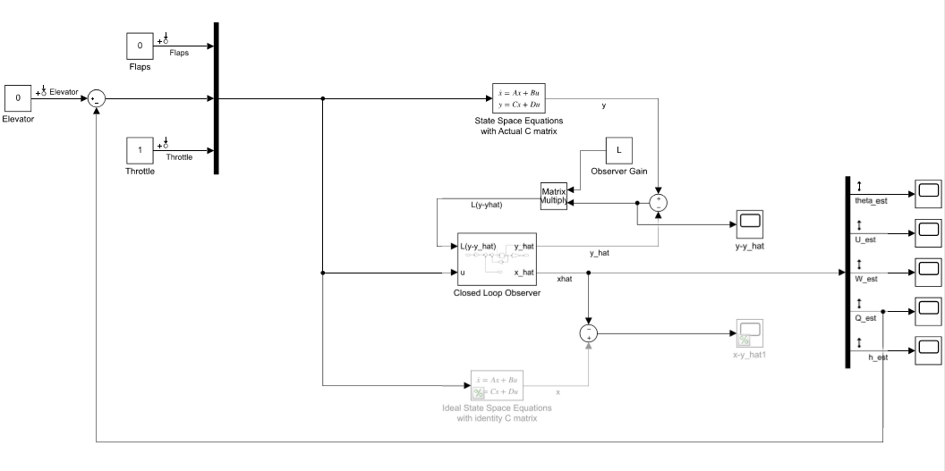

Pure Rate Feedback SAS
Goal of the SAS system is to dampen short period, as the initial response is fast and oscillatory with poles at -23.97 ± 31.29i
Short Period Mode is most related with Pitch rate Q to Elevator input
Pure Rate Feedback Block Diagram:
Open loop eigenvalue: -23.97 ± 31.29i $ω_{n}$ = 39.42 rad/s $ƺ$ = .61 $τ$ = .0417 s
Closed loop eigenvalue: -34.00 ± 0.00i $ω_{n}$ = 34.00 rad/s $ƺ$ = 1 $τ$ = .0294 s

Slide 9
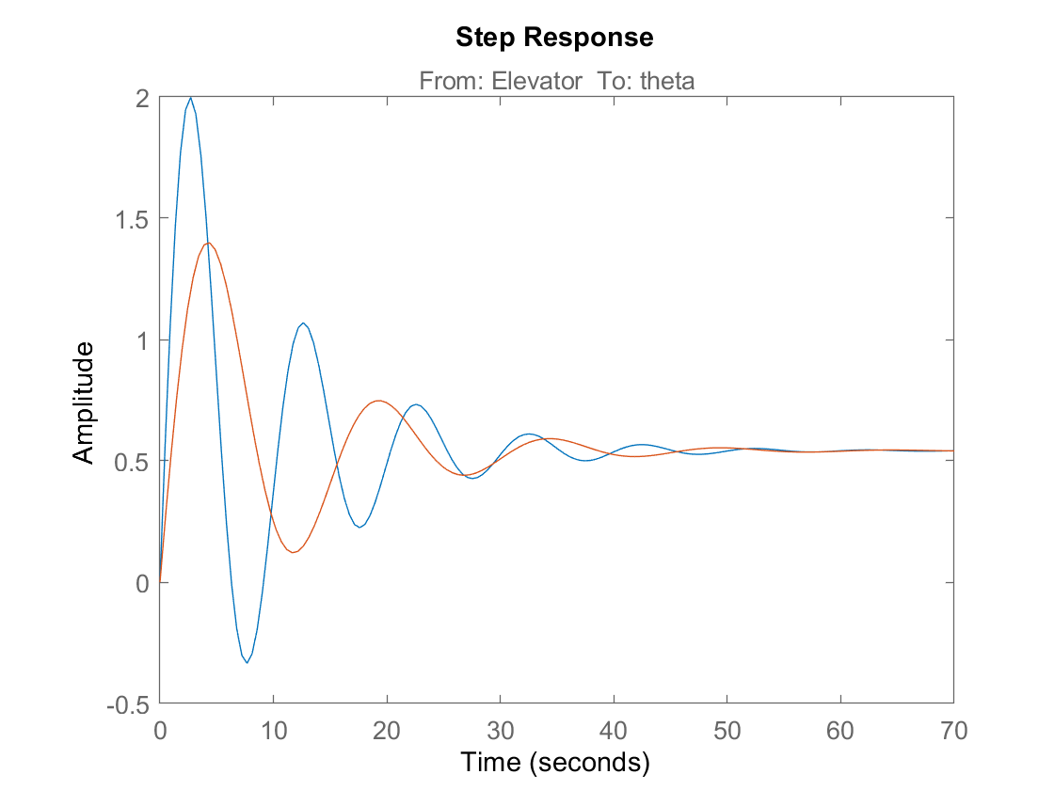
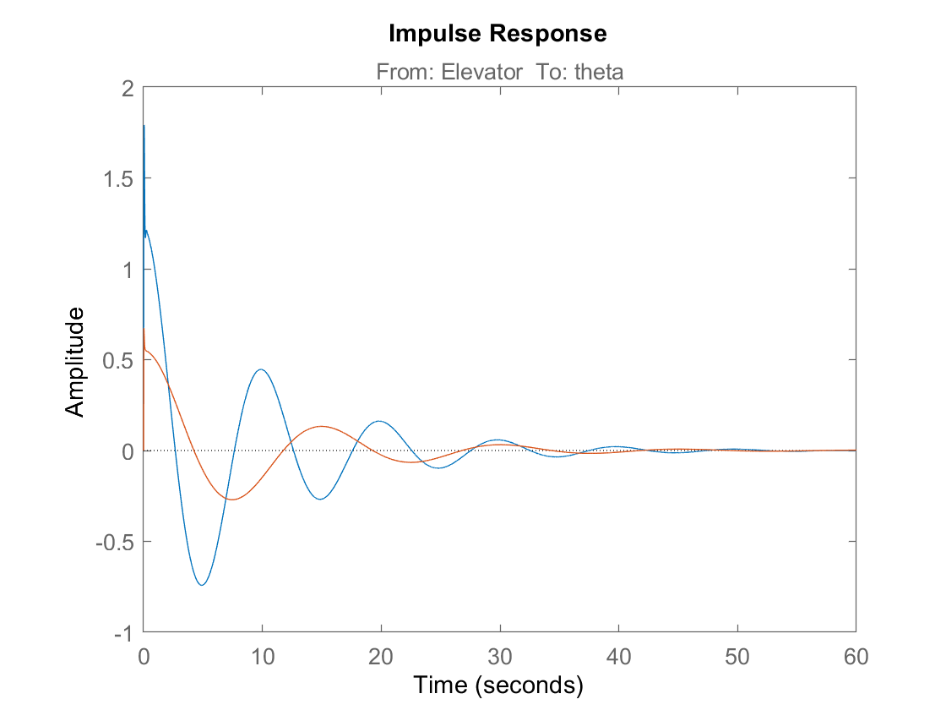
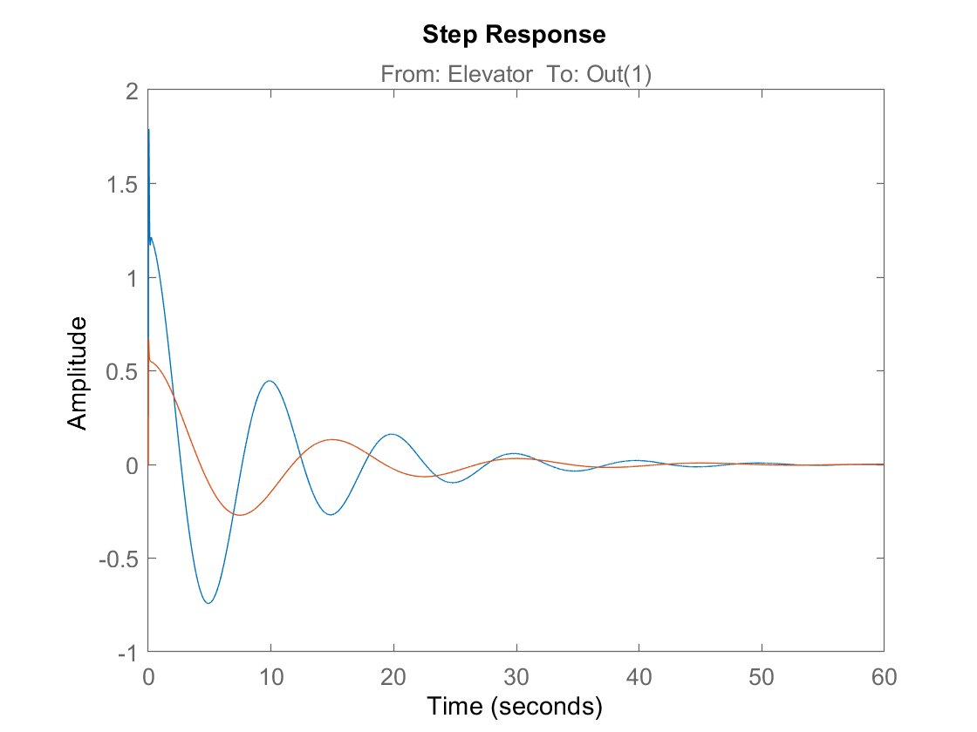
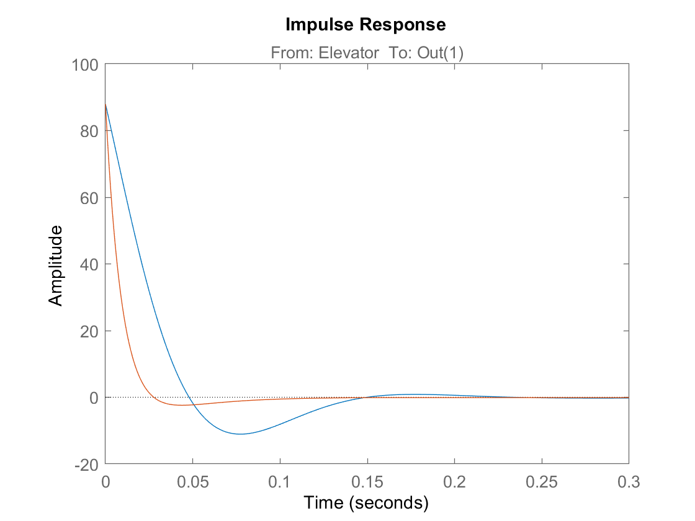
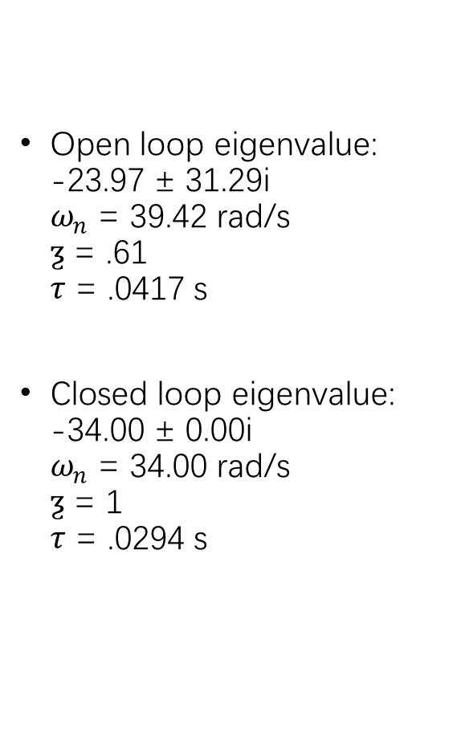
Pure Rate Feedback SAS
Open loop eigenvalue: -23.97 ± 31.29i $ω_{n}$ = 39.42 rad/s $ƺ$ = .61 $τ$ = .0417 s
Closed loop eigenvalue: -34.00 ± 0.00i $ω_{n}$ = 34.00 rad/s $ƺ$ = 1 $τ$ = .0294 s

Slide 10
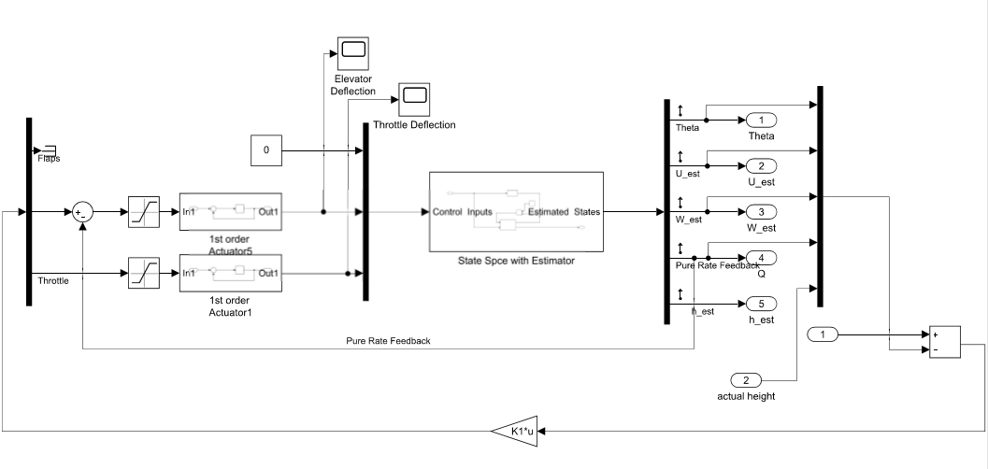
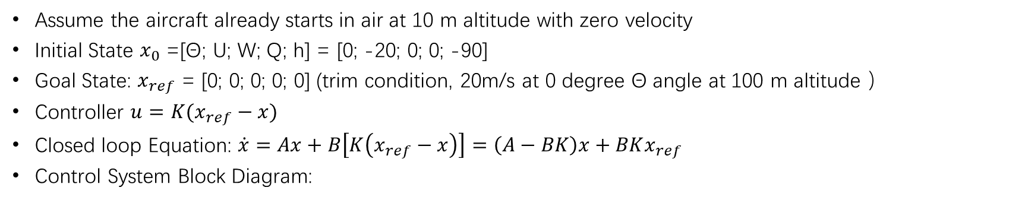
Automatic Takeoff with LQR
Assume the aircraft already starts in air at 10 m altitude with zero velocity
Initial State $x_{0}$ =[Θ; U; W; Q; h] = [0; -20; 0; 0; -90]
Goal State: $x_{ref}$ = [0; 0; 0; 0; 0] (trim condition, 20m/s at 0 degree Θ angle at 100 m altitude ）
Controller $u=K(x_{ref}−x)$
Closed loop Equation: $\dot{x}=Ax+B\left[K\left(x_{ref}−x\right)\right]=\left(A−BK\right)x+BKx_{ref}$
Control System Block Diagram:

Slide 11
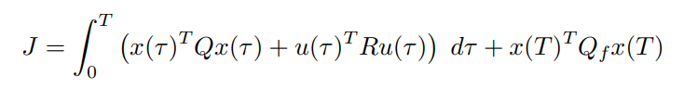
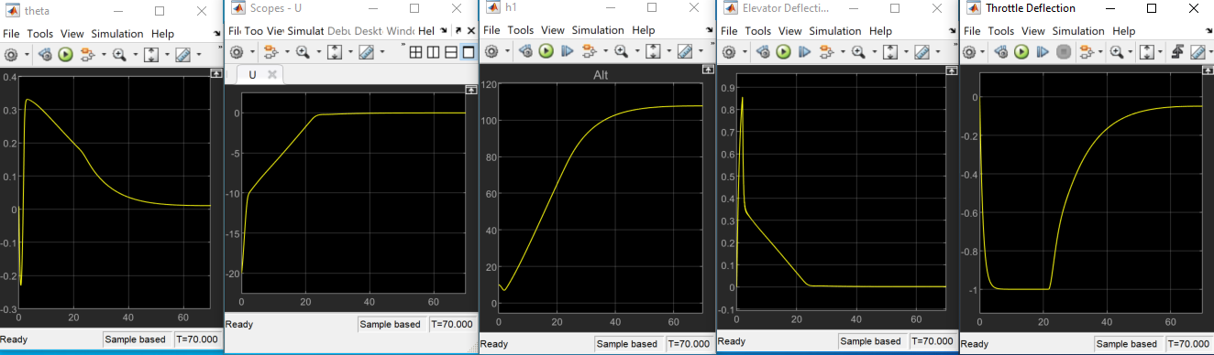
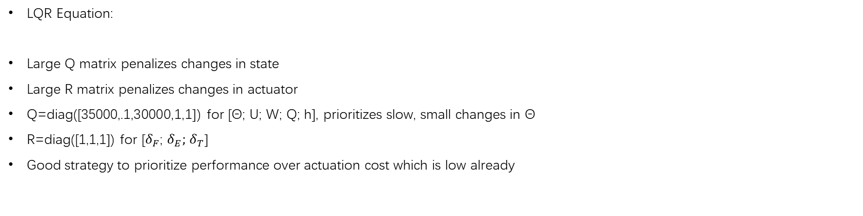
Automatic Takeoff with LQR
LQR Equation:
Large Q matrix penalizes changes in state
Large R matrix penalizes changes in actuator
Q=diag([35000,.1,30000,1,1]) for [Θ; U; W; Q; h], prioritizes slow, small changes in Θ
R=diag([1,1,1]) for [$δ_{F}$; $δ_{E};$ $δ_{T}$]
Good strategy to prioritize performance over actuation cost which is low already

Slide 12
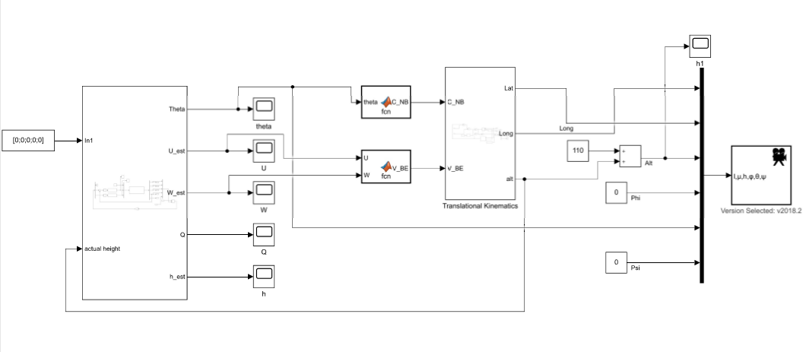
Automatic Takeoff with LQR
Top level block diagram with FlightGear
FlightGear Demonstration: https://www.youtube.com/watch?v=ZxiTEh3dW9o

Slide 13




Contents
System Overall Block Diagram
--Basic Blocks & Attached Blocks
Non-linear System Analysis.
System Linearization.
--Steady State Analysis.
--Lateral Motion Control (Wash out Filter).
--System Discretization
Aerodynamic Analysis for Sonic Flight
--Model Aero-coefficient Analysis in XFLR5
--The CFD & FEA in ANSYS
Simulation
--Skidded to Turn in FlightGear.
Notes:
Okay, Thank you sen for the demonstration There’re 5 parts of my Presentation

Slide 14

Design Diagram
STATE EQUATIONS
MATLAB & Simulink
Nonlinear System Blocks
Trimmed System
ASW28 DATA
Discretized System
Linear System
CFD
Aerodynamic Analysis
SISO System
MIMO System
ANSYS & XFLR5
Aero
coefficients
FlightGear v3.0
Controller & Filter Design
Lateral Motion Control
Notes:
From the Design Diagram, the state equation and model data are used to build the nonlinear system
Then the Model is trimmed, linearized and also discretized for Lateral motion control & digital control.
Also the data is used for the Aerodynamic analysis.

Slide 15
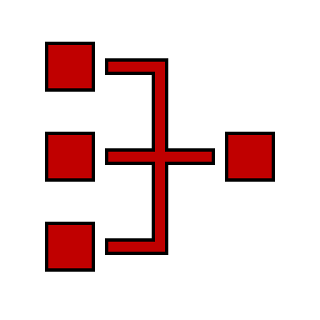
System Overall Block Diagram
Basic Control Blocks
Attached Control Blocks(AeroSurf & Propeller)
Notes:
In the first part

Slide 16
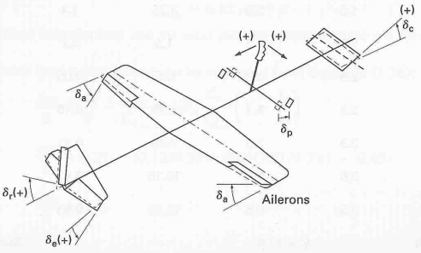
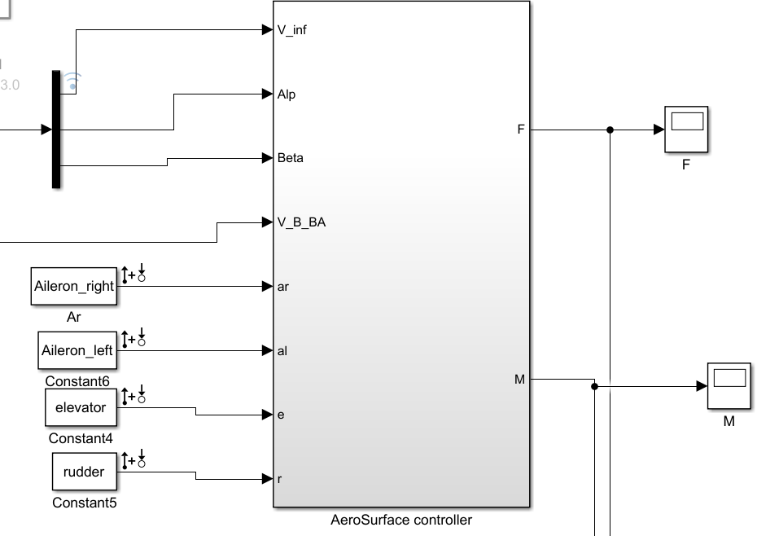
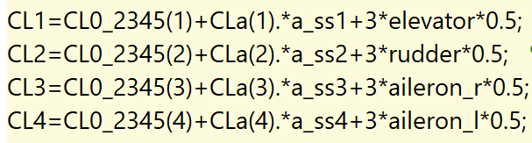
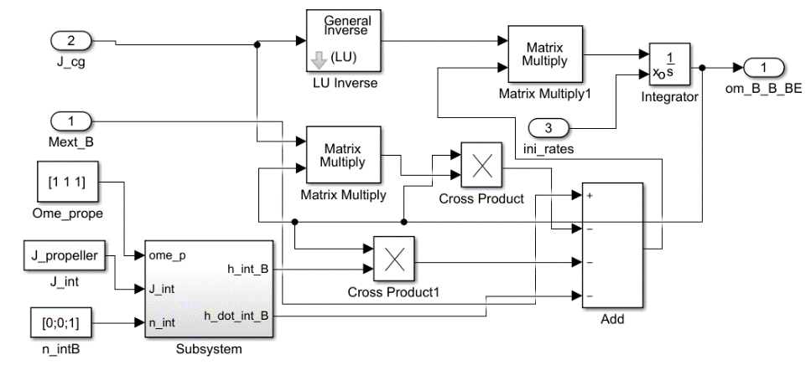
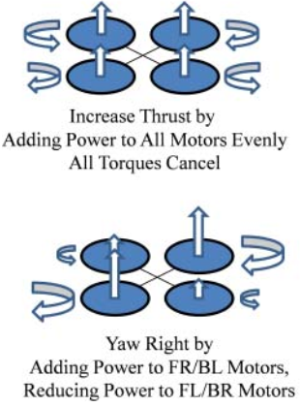
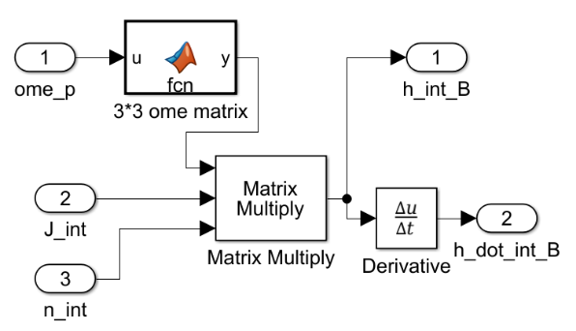
System Block Diagram
Basic Control Blocks
Translational Kinematics
Translational Dynamics
Rotational Kinematics
Rotational Dynamics
Propeller Control Diagram
Aero-Surface Control
Notes:
The Basic control blocks along with Aero surface and propeller control built through Simulink Are used for the Nonlinear system.

Slide 17
Non-linear System
Trimmed Model
PID Controller Design for System Damping
Notes:
In the Nonlinear System, the model is trimmed and Damper is designed for the system

Slide 18
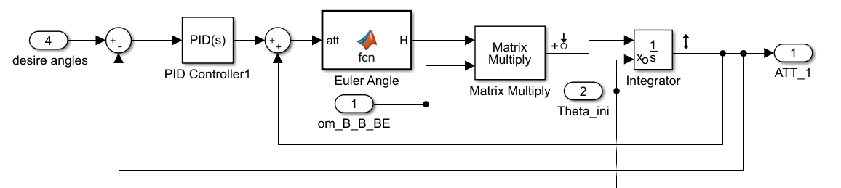
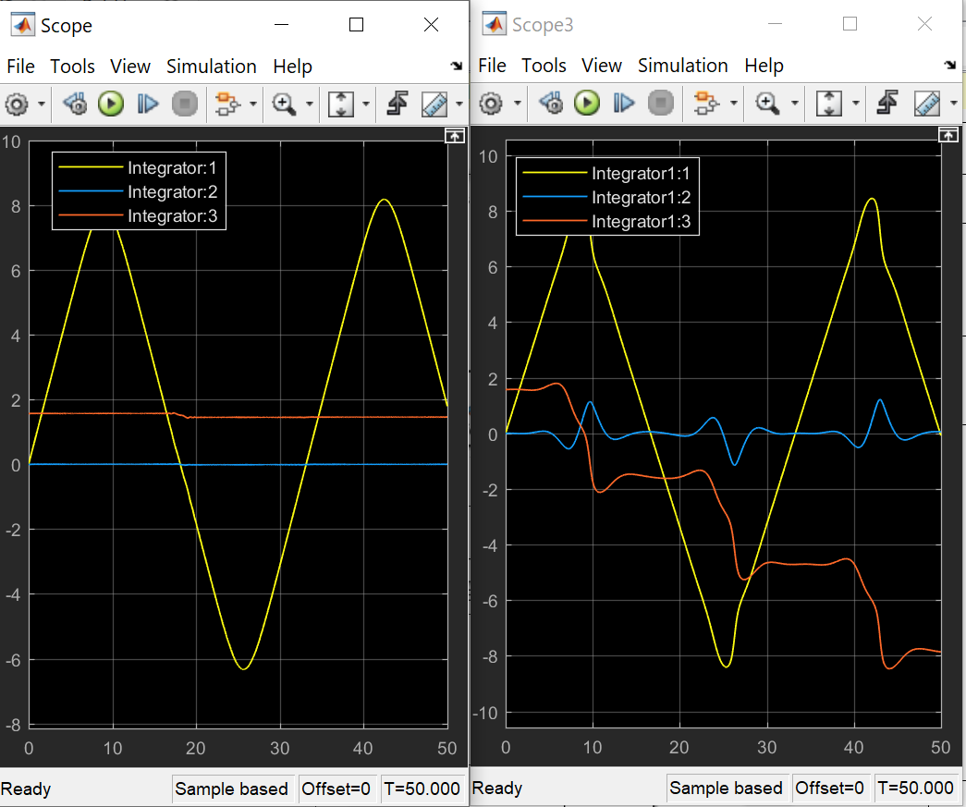
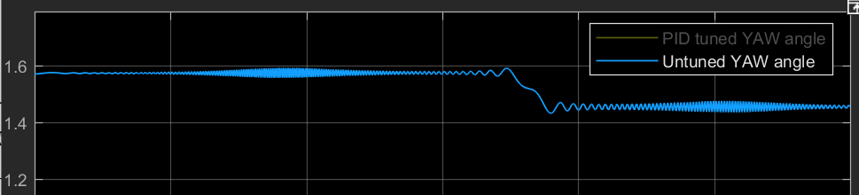
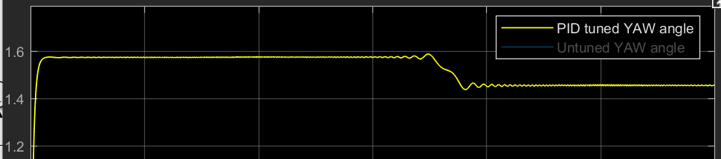
PID Controller Design for System Damping
With PID
Without PID
Yaw Angle Tuned
Notes:
From this slice , the PID designed in the Nonlinear system rotational Kinematics,
works like a damper to reduce the system vibration. Also the PID tuning method are used to Damped out the oscillation

Slide 19

System Linearization
Linearized System Behaviors & PID design
Steady State Analysis.
Lateral Motion Control (Wash out Filter).
System Discretization
Notes:
Then the system is linearized.

Slide 20
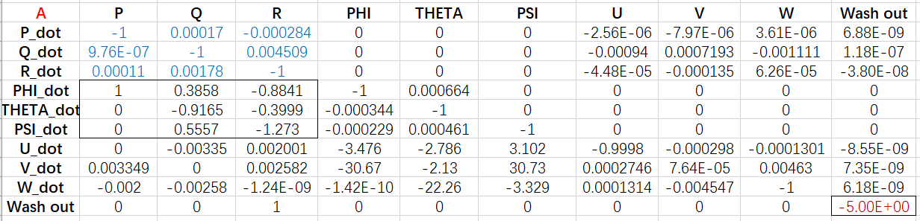
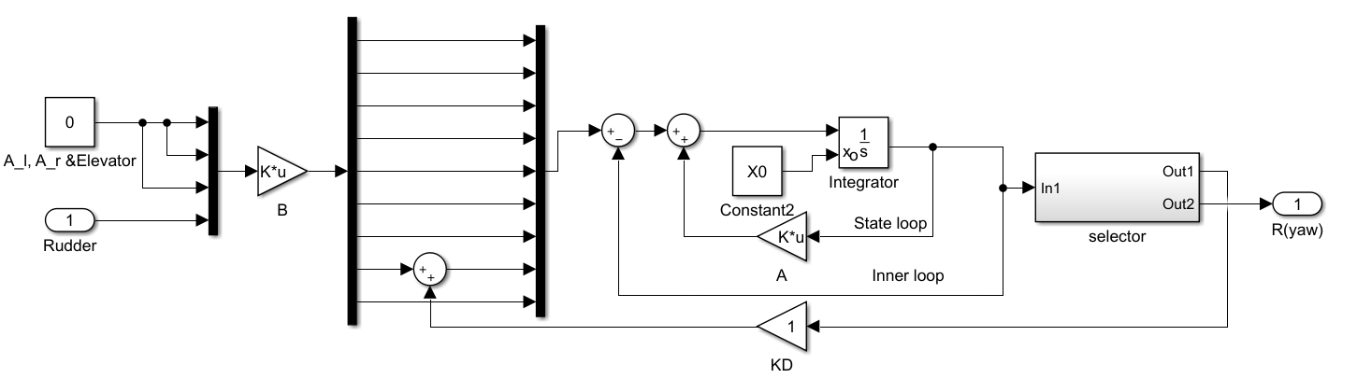
Model Linearization
Notes:
This Slice shows the matrix A which is slightly different from the lecture, you can see that the three of the Euler angles are coupled. The lateral Motion controller design are based on that.

Slide 21
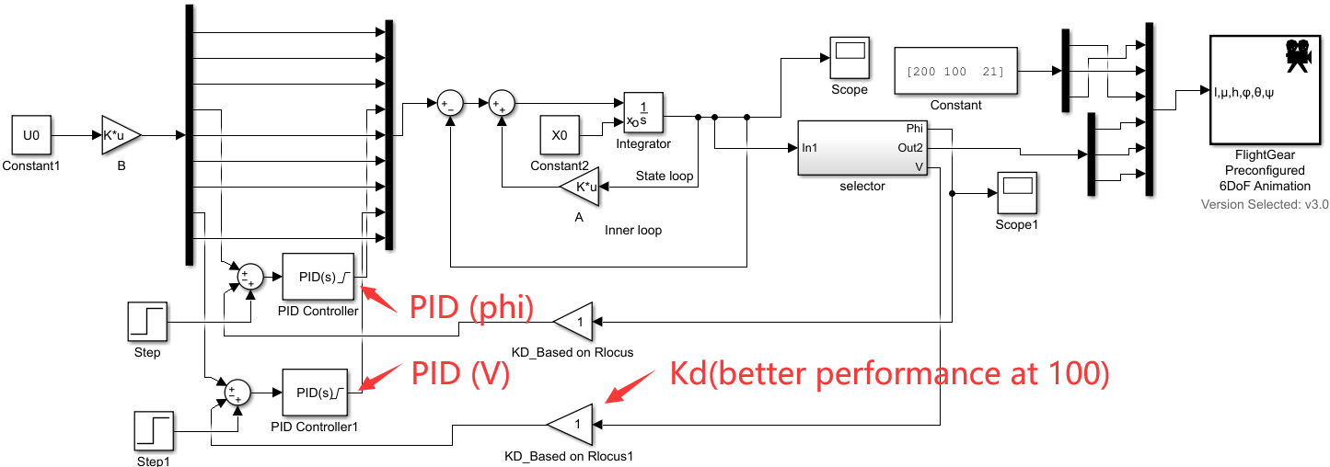
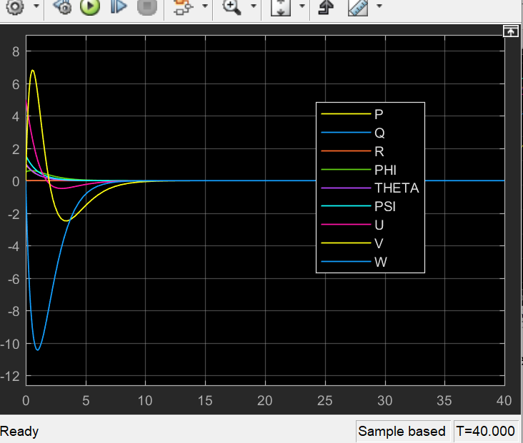
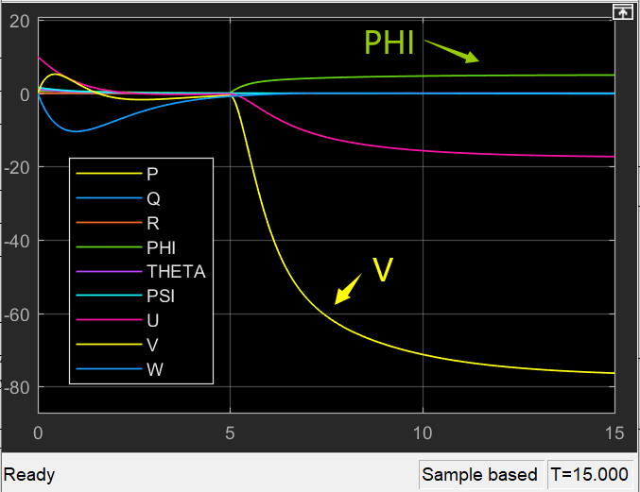
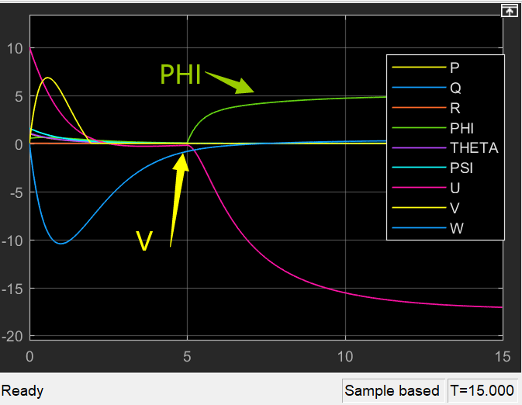
Linearized System Controller Design
No PID Applied
PID only applied to ‘phi’
PID applied to ‘phi’ &’V’
Notes:
The outputs coupling with each other which affect my system behaviors. From the second pic we can see if we only add the step input and PID controller into ‘PHI’ component, the V component would largely changed. We need to also adding PID for the V in the linearized system.

Slide 22
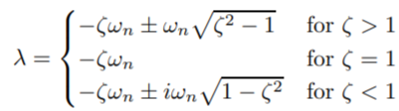
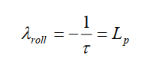
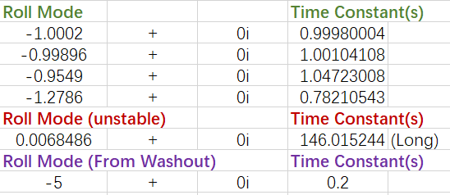
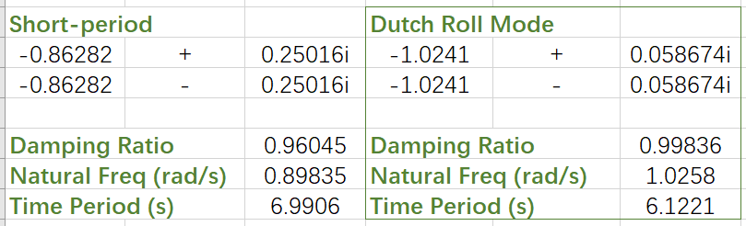
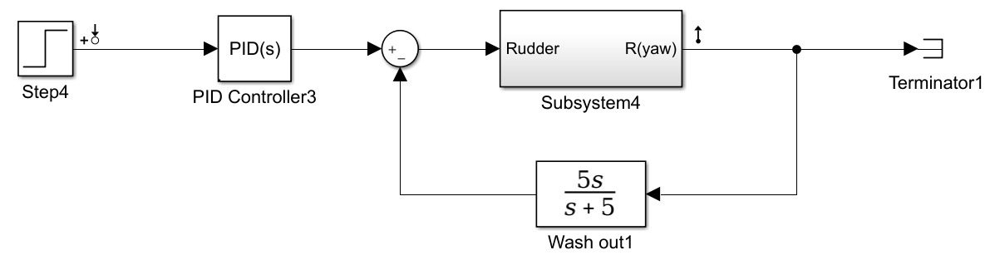
Steady State Analysis.
Oscillatory Mode
Stable Exponential Mode
HOW can I change these Dynamic Behaviors?
Notes:
From the Eigenvalue of A matrix we could Calculate the following modes
The oscillatory mode for example the dutch roll mode
is a rolling and yawing motion with some side slipping which could affect the Lateral motion stability.
Also we have Fast response and relatively slower unstable roll mode on this model.
To be noticed, the washout filter provides an extra short roll mode.

Slide 23
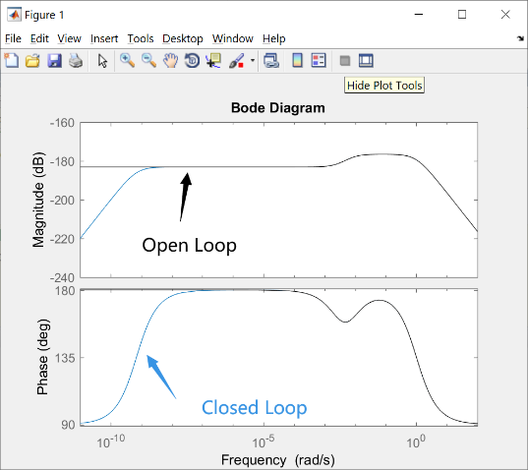
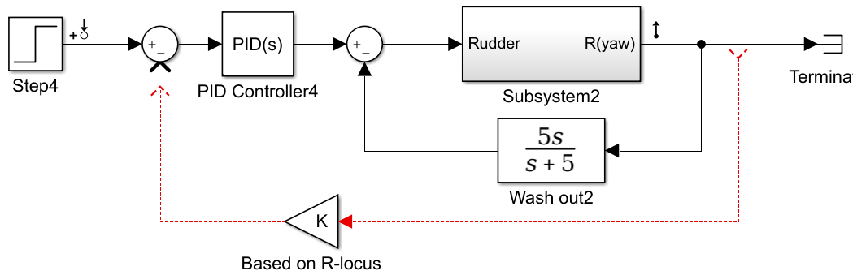
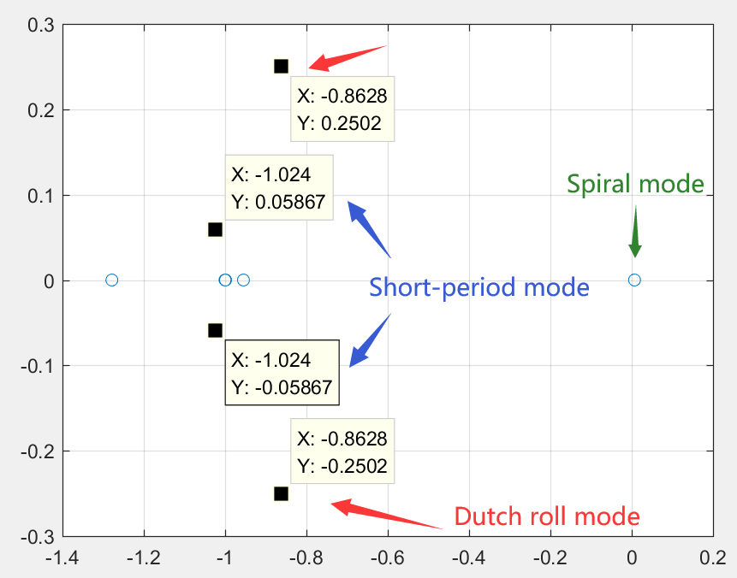
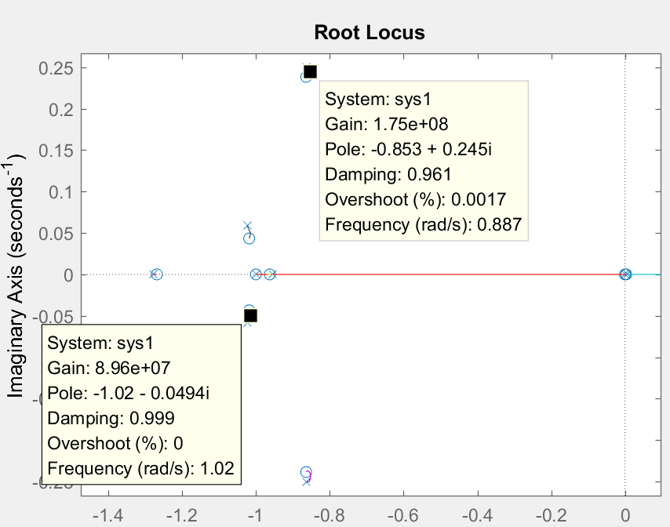
‘K’ Design Using R-locus
Bode in Freq Domain
Rlocus in Time Domain
Eigenvalue(A) Distribution
Notes:
From the Eigenvalue distribution and R-locus figure, we could see that They are corresponding to each other.
By changing the Gain in rlocus, the damping and frequency of the modes can be changed.

Slide 24
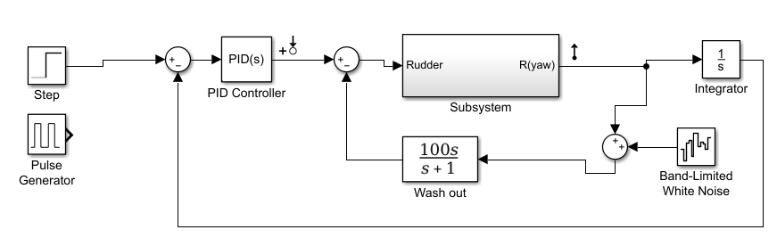



Wash Out Filter
(a)
(b)
Washout Filter removes slowly-changing component and preserves the fast-changing component in INPUT
OUTPUT remains unchanged
(a)
(a)
(b)
Notes:
A washout filter works is similar to taking a derivative of the input: sudden changes produce a large output,
Which can Damp out the little oscillation. But in this system, it doesn’t affect much of the OUTPUT yaw angle.

Slide 25










Discretized System
(Digital Control)
Figure-1 Discrete System
Figure-3 Signals
Signal: STEP & CHIRP
Sample time: 0.01s
Discrete Method: ZOH
Figure-2 Discrete VS Continuous
Notes:
For this part the linearized system including the input and PID are totally discretized using ZERO ORDER HOLD.
We can see the slight difference between discrete and continuous while the step time is so small OR the magnitude of the input is large enough.

Slide 26

Aerodynamic Analysis
for Sonic Flight
FEA in ANSYS
CFD & Wind Tunnel Analysis in ANSYS
Aero-coefficient Comparison (Alpha=Beta=0[deg])
Notes:
For this part, the FEA&CFD Analysis are applied to this model.

Slide 27




The Aerodynamic Analysis in ANSYS
Model Name | ASW28
Velocity(m/s) | 400
Temperature(ºF) | 77
Altitude(m) | 1000
Air Density(kg/m^3) | 1.074
Pressure Distribution
Finite Element Analysis(FEA)
Cephalic Cone
Notes:
I used ANSYS to simulate the fluid filed and set up the flying parameters like the table shows. To be noticed, the alpha and beta are set to be zeros.

Slide 28




Wind Tunnel & CFD Analysis in ANSYS
Velocity Distribution
(Alpha=Beta=0[deg])
U-Velocity
V-Velocity
W-Velocity
Figure. Velocity Contour (left); [u; v; w] in Longitudinal Symmetry Plane
Notes:
From the velocity Distribution figure, we could see that UV&W velocities contribute differently to the Whole Velocity among Longitudinal symmetry plane,

Slide 29




Aero-coefficient Comparison (Alpha=Beta=0[deg])
0.06277
Cl
0.000285
Cd
ANSYS (x-time, y-coefficient)
XFLR5
Notes:
Data in ANSYS is inflected by many parameters. From the comparison, We could see the slightly different between ANSYS and XFLR5 Analysis. Also we should know that the sonic flying air turbence could be so unstable. The result may not be so reliable. However, it provides a great way for the analysis.

Slide 30

Simulation
Pilot Control System
Skidded to Turn Simulation

Slide 31



Pilot Control Simulation
Autopilot Roll Angle Control Theorem
Pilot Control (with Time-delay & Disturbance)
Notes:
In this part, The Time delay and band noise are added to the pilot control system to simulate the real situations. According to the control theorem, the inner and outer loop are also added to the system.

Slide 32







MIMO System Control
No Signal Input
Large Signal Input
Lateral Motion Control
Notes:
In the MIMO system, the Euler angles are integrated from PQR. The figure shows that the position and size of command and input can change the flight behaviors.

Slide 33





Lateral Motion Control-Skid to Turn
Skid to Turn angles
Skid to Turn Simulation
Notes:
As the dashboard shows, the ASW28 are doing skid to turn in the midair. The commands are given to Rudder and Ailerons

Slide 34






Skid to Turn-Simulation

Slide 35
References
[1]. STEVENS, B.L., F.L. LEWIS and E.N. JOHNSON, Aircraft Control and Simulation Third Edition Dynamics, Controls Design, and Autonomous Systems, United States of America: John Wiley & Sons, Inc., Hoboken, New Jersey
[2]. Dr. Nelson, R.C., Flight Stability and Automatic Control 2nd Ed.
[3]. Kaloust, J., C. Ham and Z. Qu, Nonlinear autopilot control design for a 2-DOF helicopter model.
[4]. Chen, C., System Theory and Design. Second Edition ed: Oxford University Press.
[5]. Yechout, T.R., et al., Introduction to aircraft flight mechanics: American Institute of Aeronautics and Astronautics, Inc.1801 Alexander Bell Drive, Reston, VA 20191-4344.
[6]. Chambers, J.R. and R.M. Hall, Historical Review of Uncommanded Lateral-Directional Motions at Transonic Conditions. JOURNAL OF AIRCRAFT, (Vol. 41, No. 3, May–June 2004).
[7]. Rauf, A., et al. Aerodynamic modeling and state-space model extraction of a UAV using DATCOM and Simulink. 2011: IEEE.
[8]. Rysdyk, R., Course and Heading Changes in significant wind. JOURNAL OF GUIDANCE, CONTROL, AND DYNAMICS, (Vol. 30, No. 4, July–August 2007).
[9]. Michael Basler, M.S., et al., The FlightGear Manual for FlightGear Version 3.6.0.
[10]. Kubica, F. and T. Livet, Flight Control Law Synthesis for A Flexible Aircraft. American Institute of Aeronautics, 1994.
[11] Tanner Austin Sims, Design and Control Considerations for a Skid-to-Turn Unmanned Aerial Vehicle, 2009

Slide 36

Thanks for Watching!!
Questions ?

